Slide 1
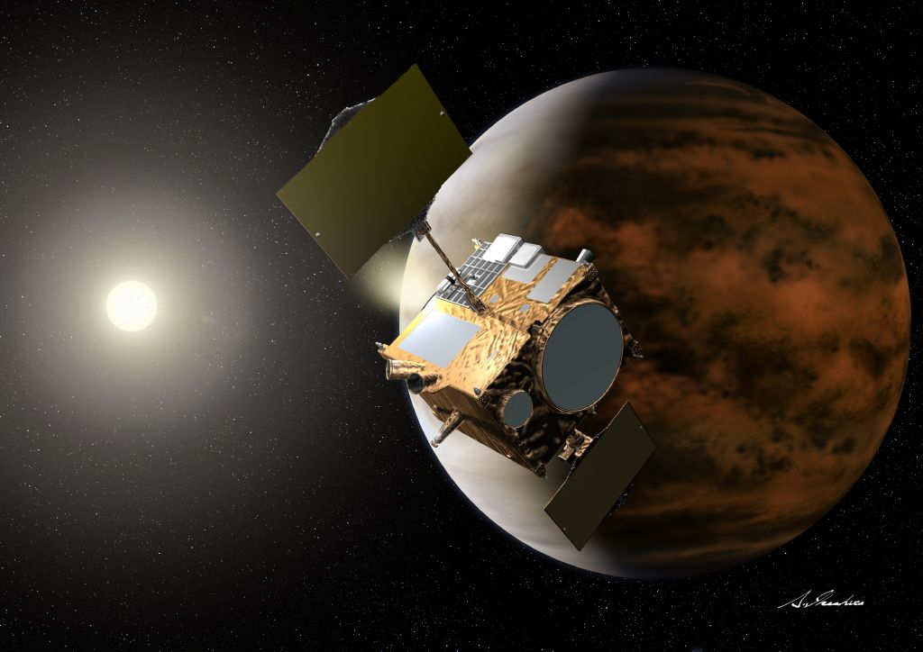



Understanding Meteor Ablation in the Atmosphere of Venus
Claire H. Blaske, Joseph G. O’Rourke
Credit: JAXA/Akihir Ikeshita

Slide 2
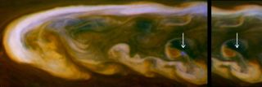
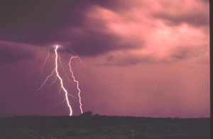
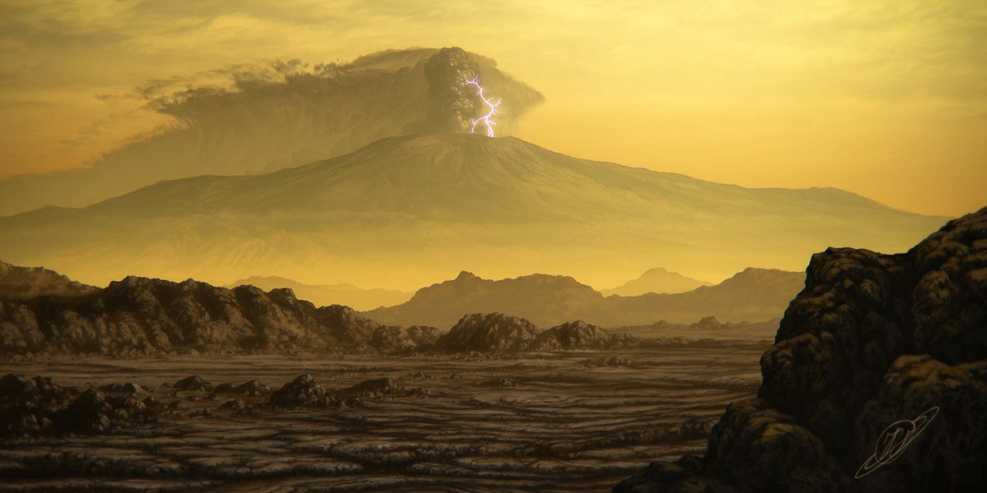
Lightning on Planetary Bodies
Credit: NASA/JPL-Caltech/SSI
Credit: NOAA Photo Library
Credit: @VitkusJustinas , Twitter

Slide 3
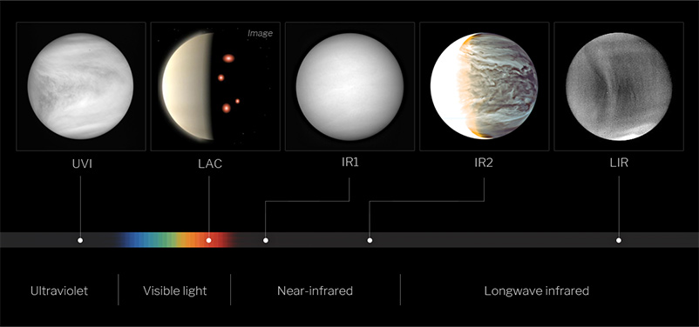
I Spy… A Lightning Flash?
Several missions have tried to detect lightning at Venus
Two searches, done by the Akatsuki mission and at Mt. Bigelow, have recorded optical flashes - 8 in total.

Slide 4
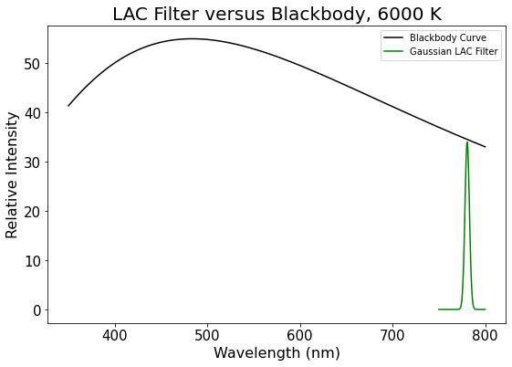
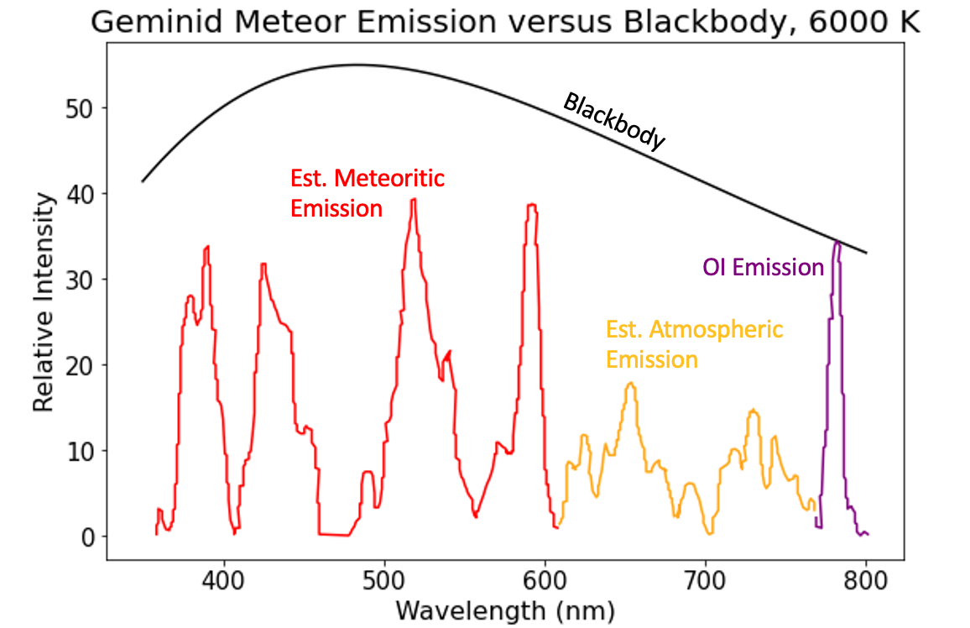
Excited Oxygen Triplet = <1% of Blackbody

Slide 5
~1-2 kg Meteors Do Not Emit as Blackbodies

Slide 6

Determining Energy - f_{OI}
Mass +
Velocity
Do different minerals / rock types change this fraction?
% OE in LAC filter
% Kinetic Energy
as Optical Energy
½ M•V²
Luminous Efficiency
(Popova et al. 2019)

Slide 7
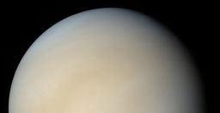
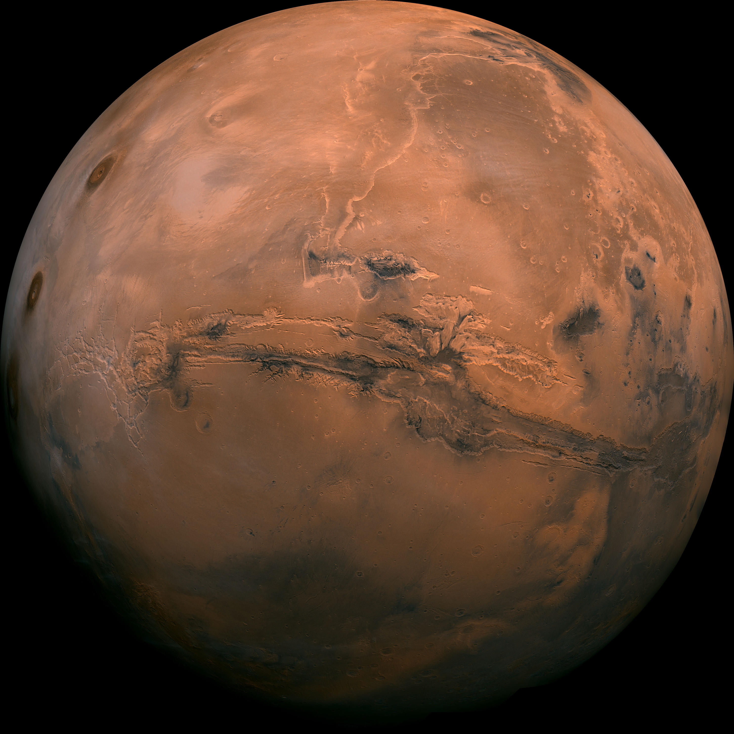
Mars Surface = Venus 100 km Up?
95% CO₂
2.6% N₂
1.9% Ar
0.16% O₂
0.06% CO
~5-8 mbar
96.5% CO₂
3.5% N₂
Trace others
~1 mbar
Credit: NASA/JPL-Caltech

Slide 8
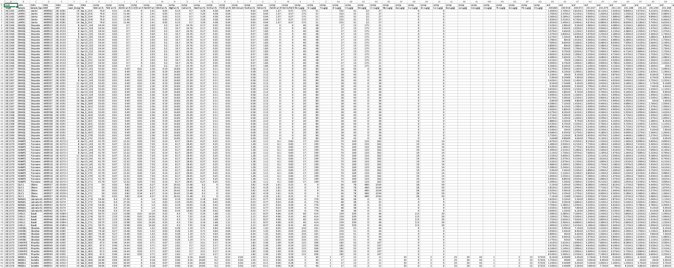
ChemCam Data: Calculate % in LAC filter

Slide 9
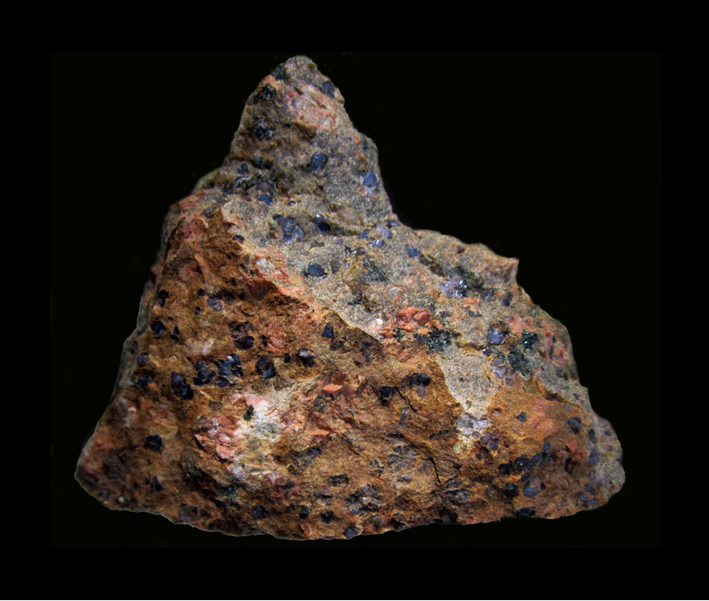
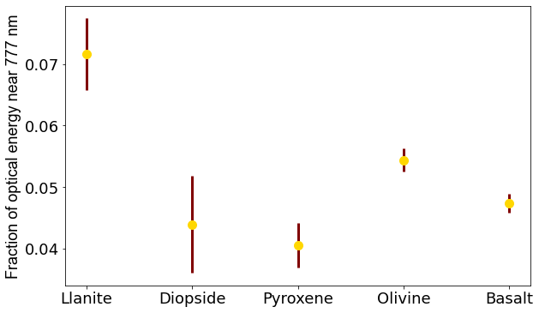
The fraction of energy at f_{OI} is > 4%
Olivine:
(Mg²⁺, Fe²⁺)₂SiO₄
Pyroxene:
(Ca,Mg,Fe)₂Si₂O₆
Diopside:
CaMgSi₂O₆
Chondrites + Achondrites:
Mostly olivine + pyroxene
Llanite (Mindat)
(Mg²⁺, Fe²⁺)₂SiO₄.
Iron-rich meteorites:
Very little oxygen!

Slide 10
Thank you!
Determining the fraction of optical energy in the LAC filter near 777 nm means we can more accurately predict the frequency of bolides ablating at Venus
Meteors might masquerade as lightning in the upper atmosphere of Venus, above the clouds
Acknowledgements: Thank you to my mentor for assistance with this project, and to the ASU/NASA Space Grant for funding this research.

